Slide 1
03 – USSD and IVR self-care

Slide 2
IVR functionalities
The built-in IVR include the following functionalities
Balance inquiry
Recharge
Language change
Phone book management (friend and family)
Forward to call center
Admin main menu
The IVR support the prompt set in multiple languages. 2 languages are included in the project scope
English Prompt set will be supplied in this IPA
Customer will need to translate to additional 2 languages prompt set
Customer will need to record the additional 2 languages prompt set
The digital format of prompt set shall be in .WAV format as below
WAVE audio, a-law, 8000 Hz, 64 kbps, mono

Slide 3
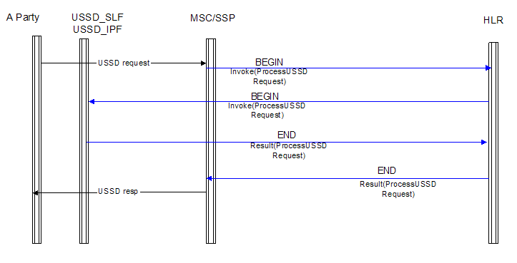
USSD recharge and info server
Basic network self-care functionalities
Voucher top up → *100*XXXXXXX#
Inquiry → *101#
Please note that the 100 or 101 is definable but must follow 3GPP

Slide 4
Thank you

